Slide 1



Laboratory experiments to study gravity wave emission from baroclinic fronts
Uwe Harlander, Costanza Rodda, Ion Borcia
with help from
Patrice LeGal and Miklos Vincze
Department of Aerodynamics
and Fluid Mechanics
Brandenburg University of Technology
Cottbus-Senftenberg
TRR 181, April 4-6, 2018

Slide 2
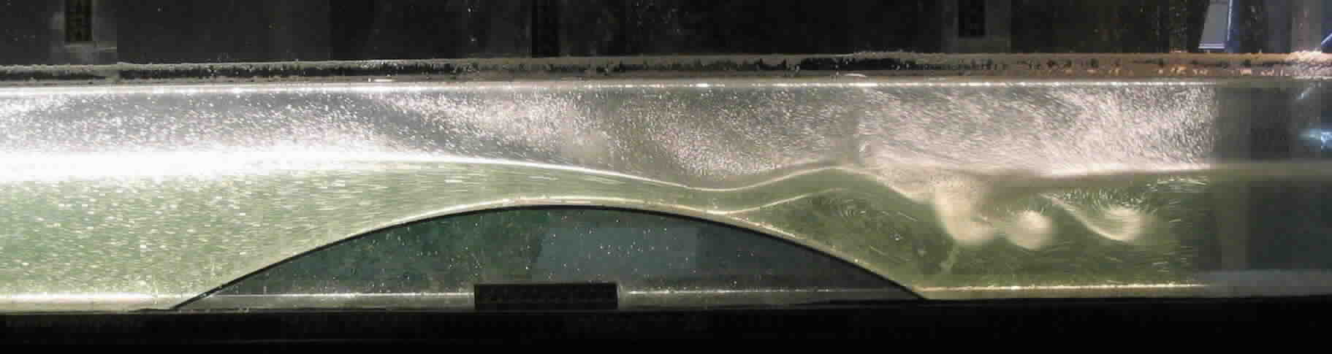
Outline
Experiments in fluid mechanics: TC, RB, variations and combinations
Baroclinic instability and the sloping convection experiment
Gravity waves in the sloping convection experiment
  Boundary layer instabilities
  Waves related to the baroclinic jet
Conclusions

Slide 3
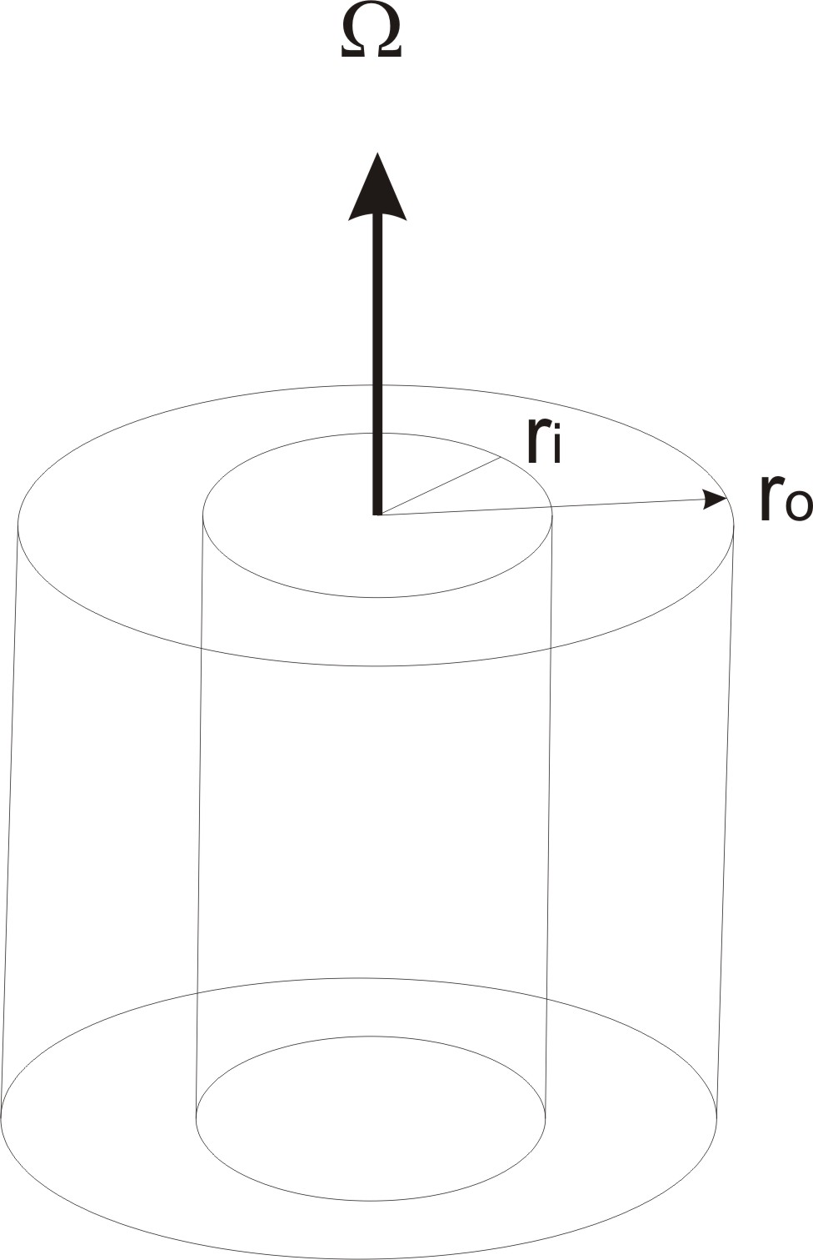
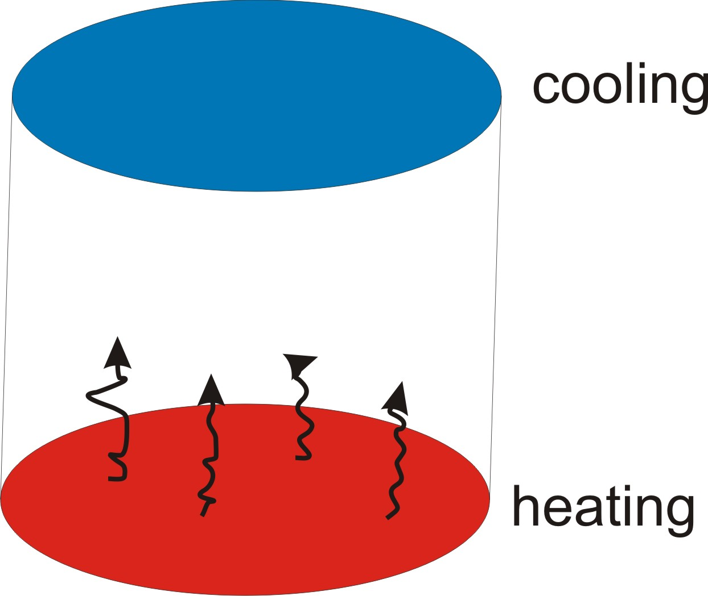
Taylor-Couette
Rayleigh-Benard

Slide 4
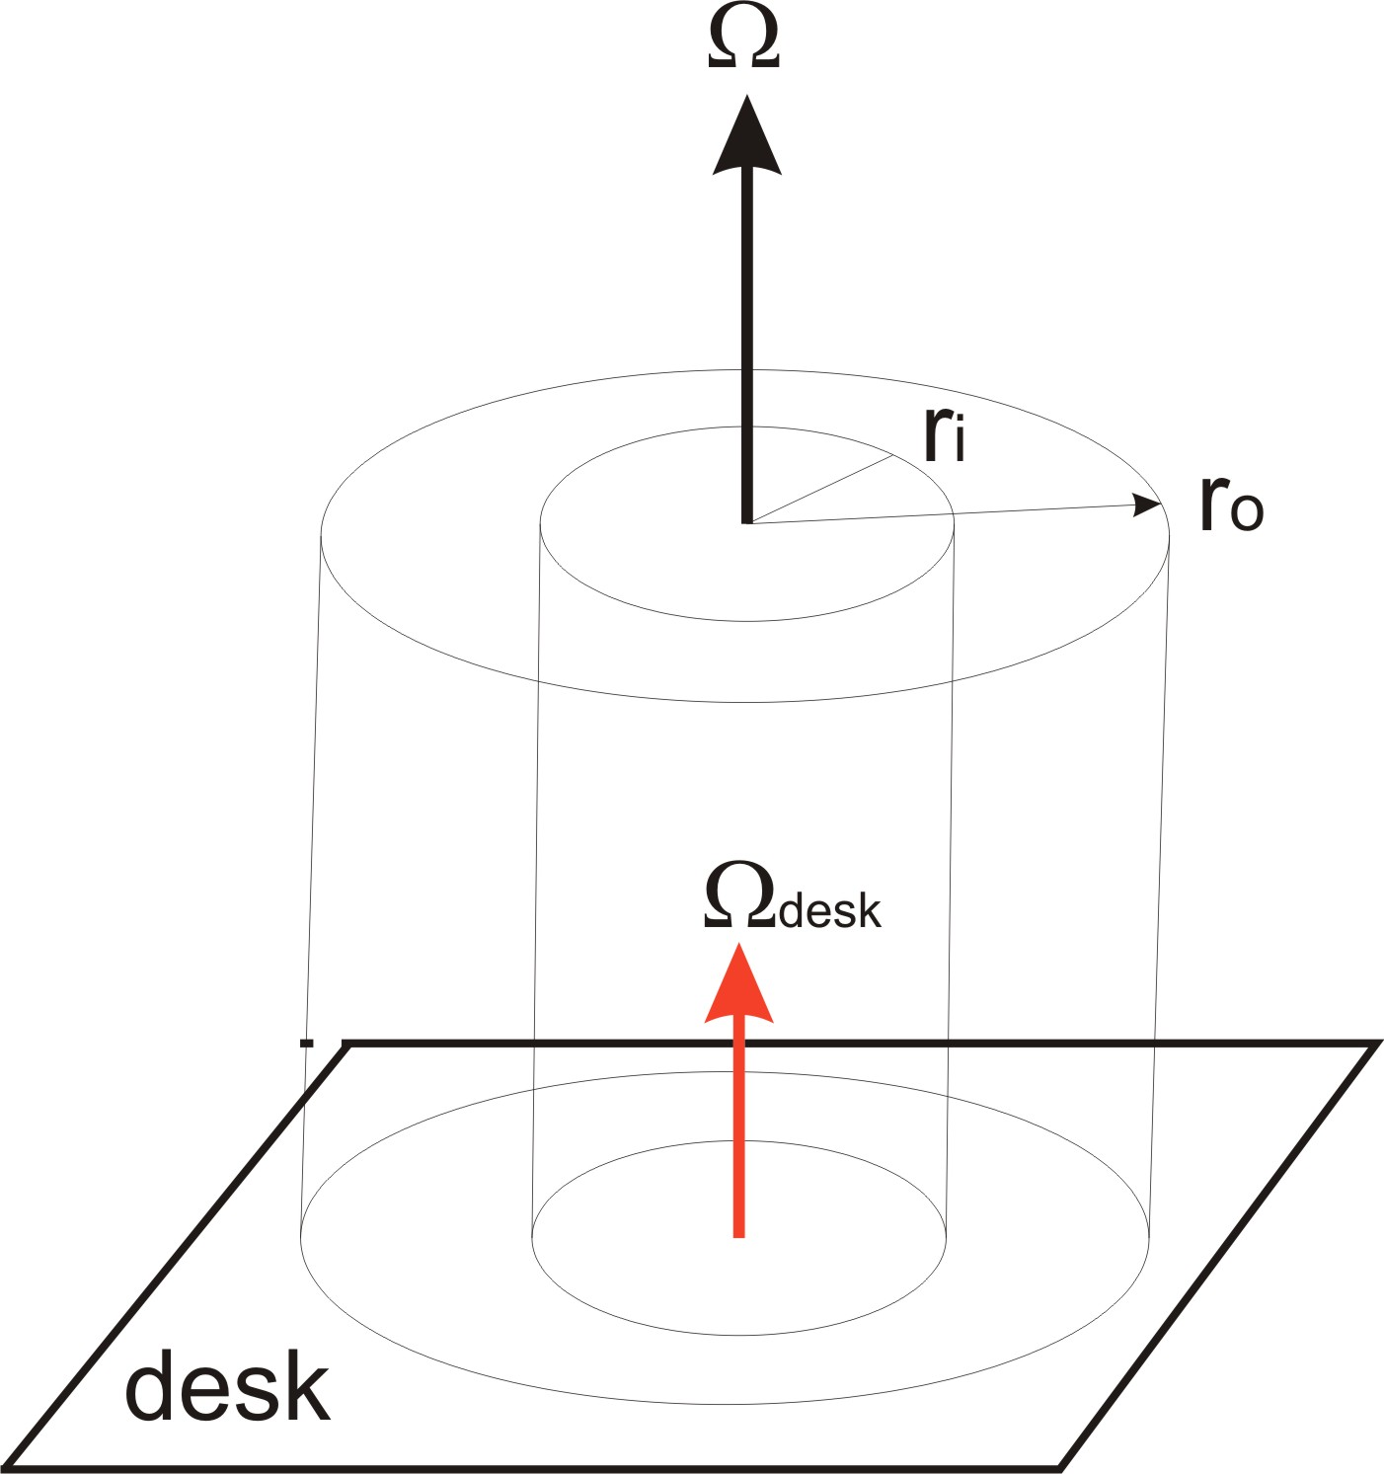
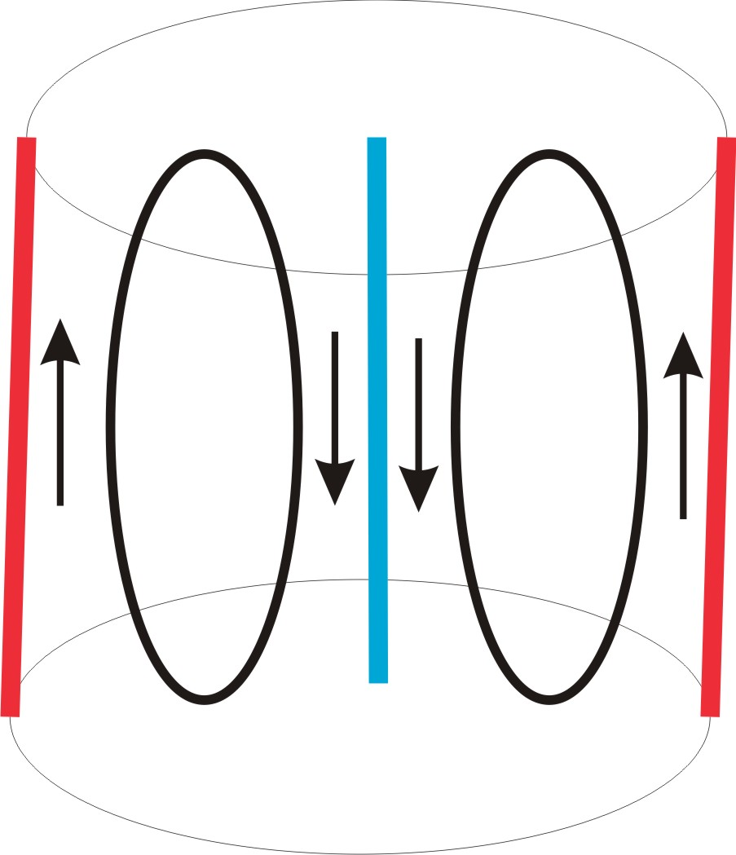
Taylor-Couette
Horizontal convection

Slide 5
Taylor-Couette
Horizontal convection

Slide 6
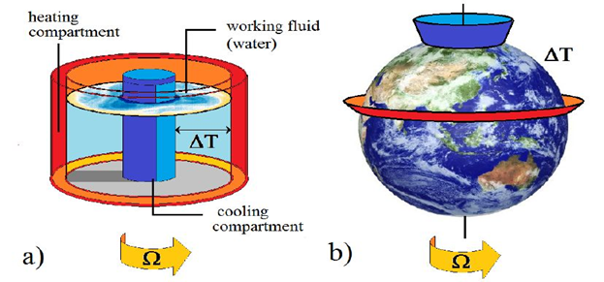
see e.g. Read et al. 1998, Chaos,9, 231-

Slide 7
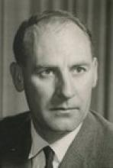
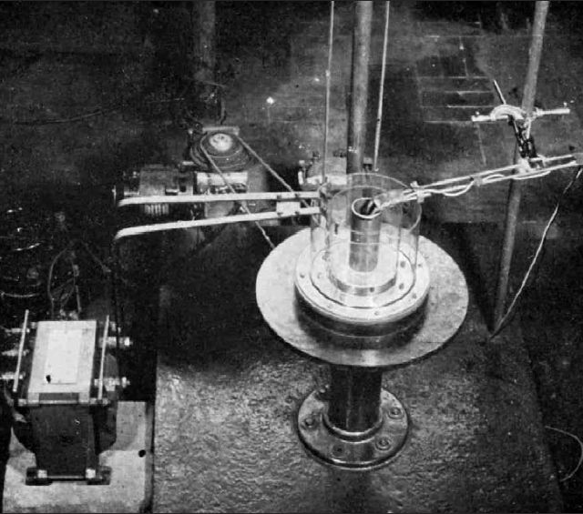
The Hide-Experiment
Prof. Raymond Hide
Original experiment used by Hide in1953
From Hide 2010, „A path of discovery in GFD“, A & G, 51, 416-

Slide 8
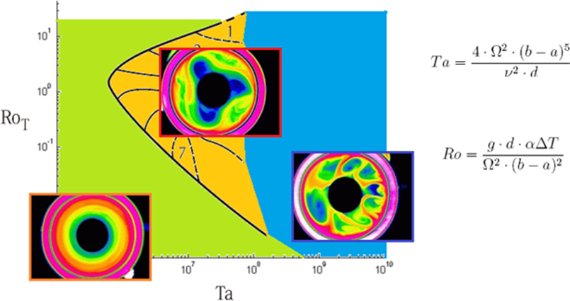
Flow regimes
=U_{T}/f L
(courtesy M. Vincze)

Slide 9
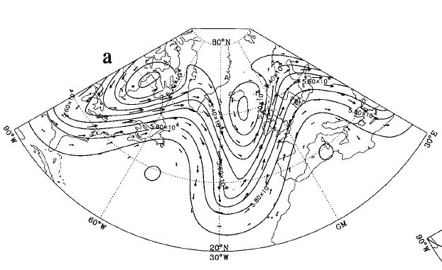
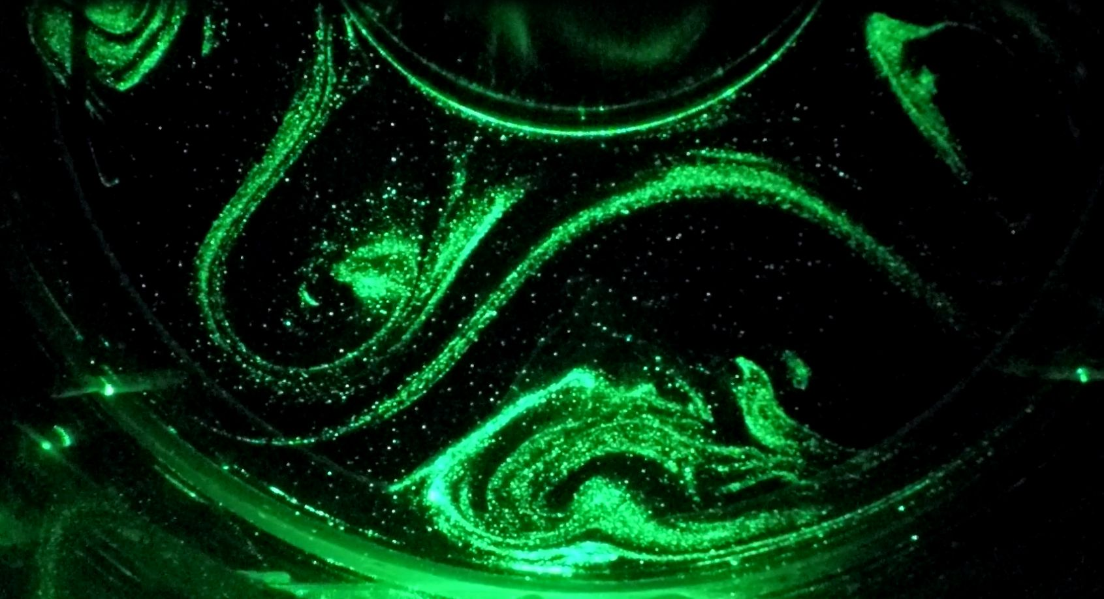
The baroclinic wave
O‘Sullivan and Dunkerton (1995); JAS, vol 52.
Kalliroscope visualisation of baroclinic wave structures, BTU C-S (courtesy by I.D. Borcia)

Slide 10
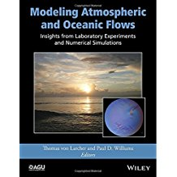
Most recent review in the AGU book published 2014 edited by Th. V. Larcher and P.D. Williams who both work on baroclinic annulus flows.
Lab studies on gravity waves in the rotating annulus:
-2-layer fluid (Lovegrove et al. (2000), QJRMS; Williams et al. (2008), JAS; Scolan et al. (2011))
-boundary layer instability in the thermally driven case (Jacoby et al. 2011)

Slide 11
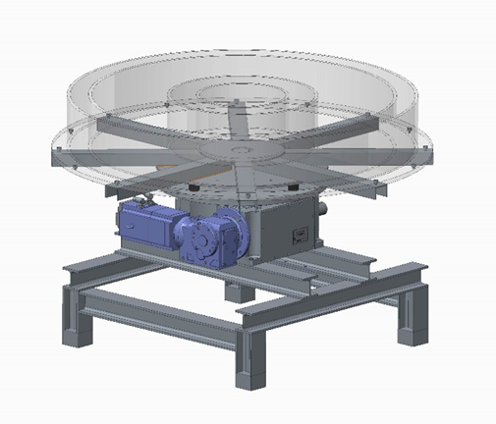
The MS-GWaves experiment
Construction drawing of the big MS-GWaves tank at BTU Cottbus-Senftenberg. Not shown is the heating /cooling system, the measurement instruments and the computer control unit.

Slide 12
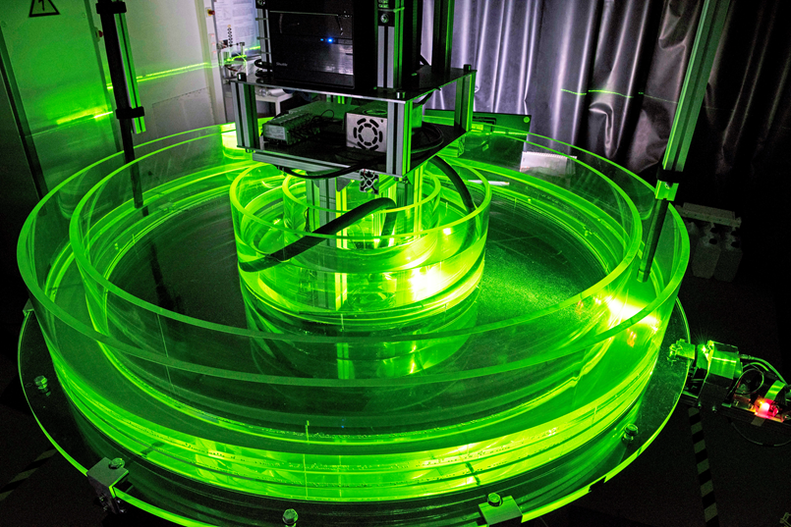

Slide 13
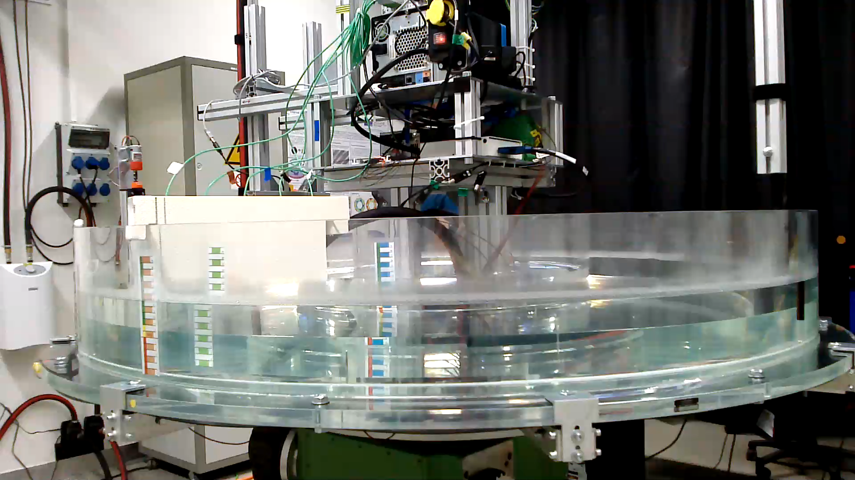

Slide 14
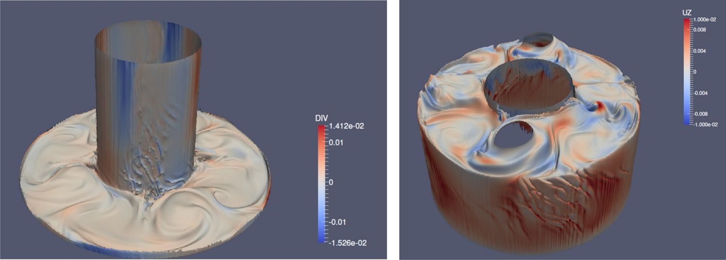
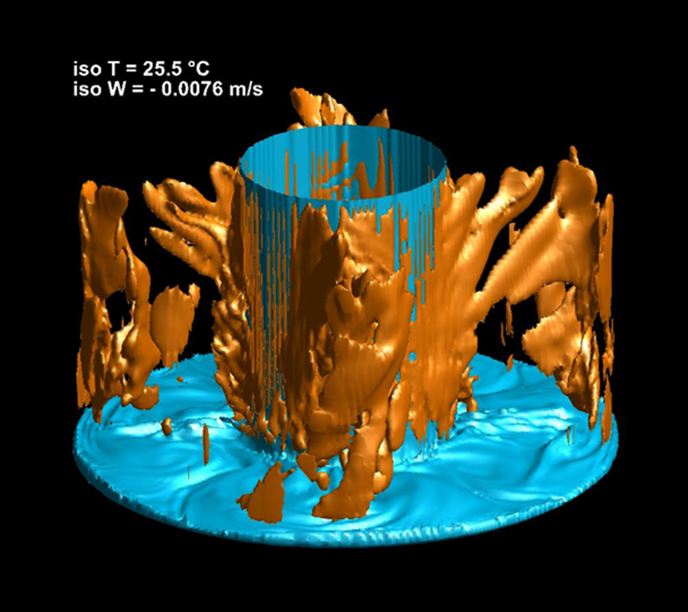
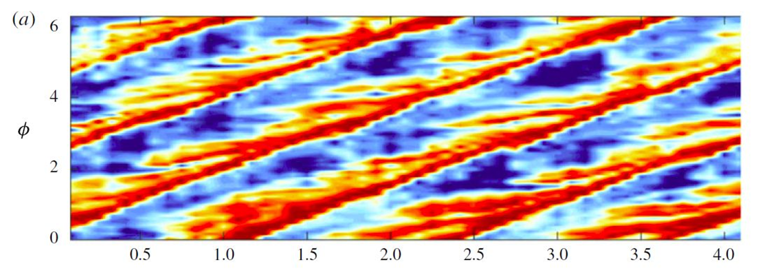
Part I: Boundary layer instabilities
Th. v. Larcher, S. Viazzo, U. Harlander, M. Vincze
and A. Randriamampianina, JFM, 2018

Slide 15
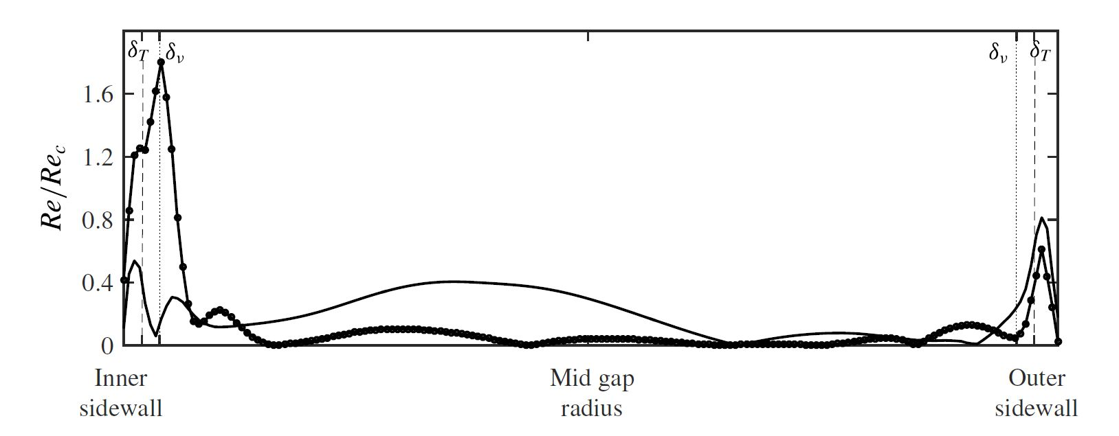
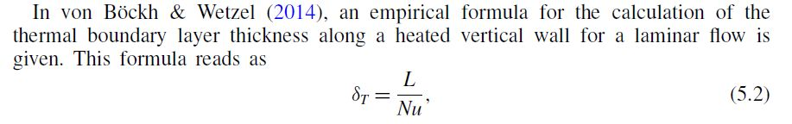
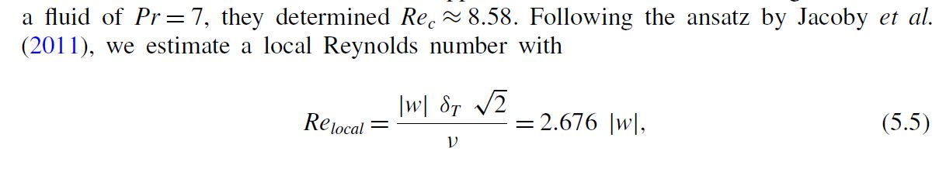
McBain, Armfield & Desrayaud (2007)

Slide 16
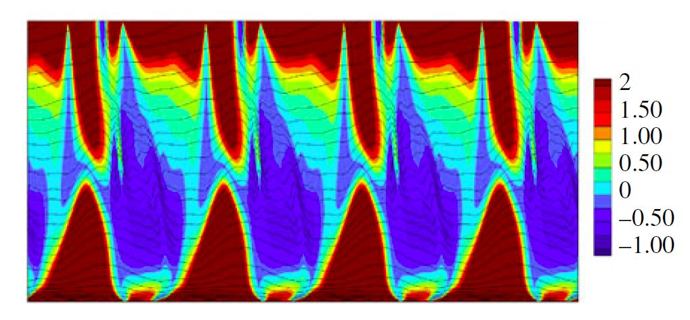
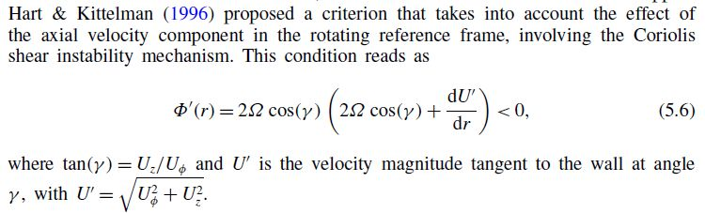

Slide 17
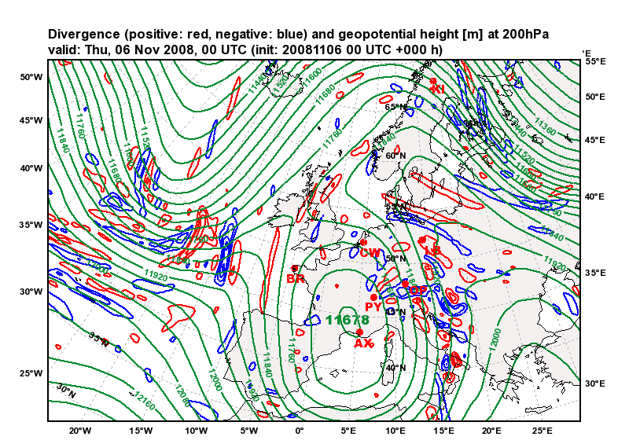
Part II: spontaneous IGW emission
Inertia-gravity waves in the atmosphere as seen in the horizontal divergence field (positive: red; negative: blue). Green lines: geopotential height. Thursday, 6 November 2008, 00 UTC.
see Vanneste 2013, Ann. Rev. Fluid Mech., 45, 147- for a review focusing theory

Slide 18
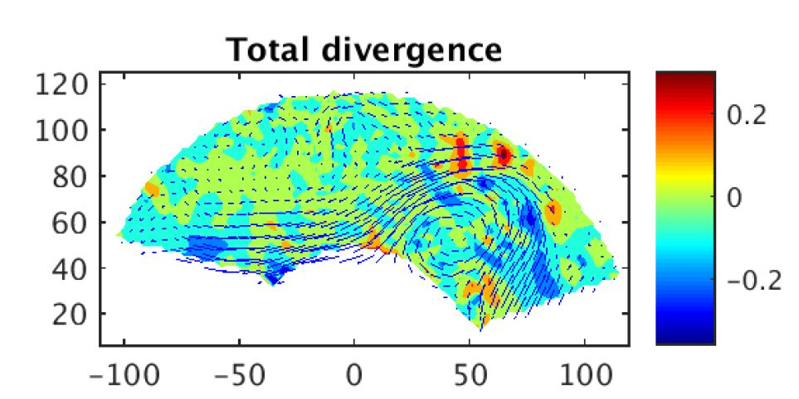
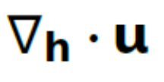
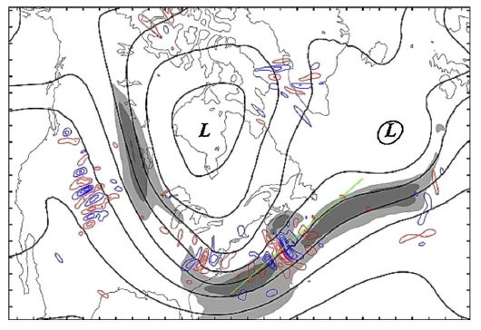
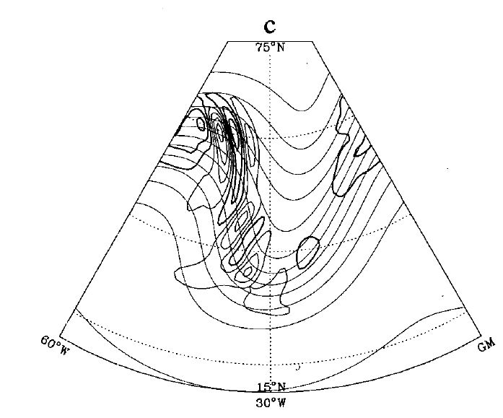
Horizontal divergency in the small tank experiment
is in the order of f
Rodda et al. 2018, „Eady, Kelvin and gravity waves in a thermohaline driven annulus experiment“, accepted by GAFD.
Wu and Zhang (2004); J. Geophys. Res., vol 109.

Slide 19
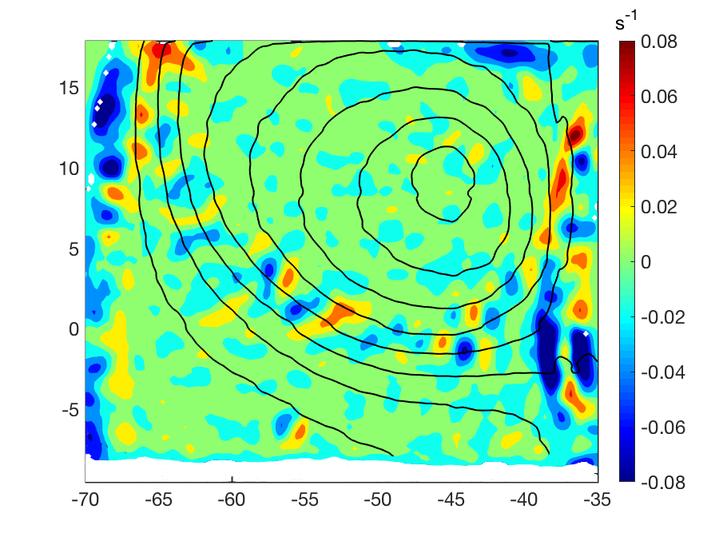
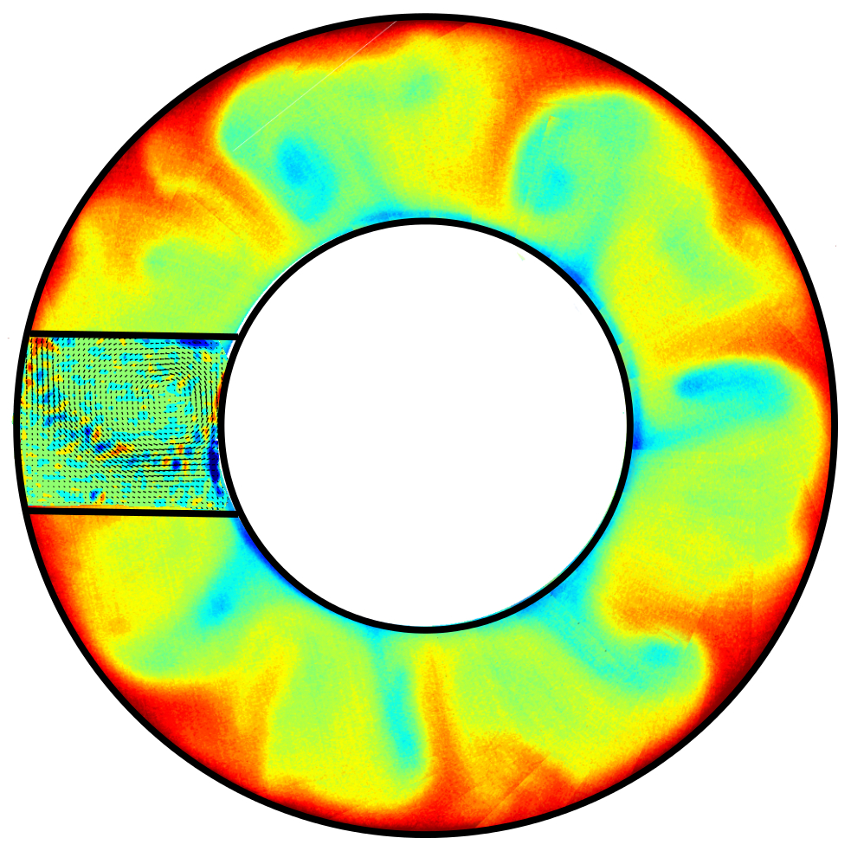
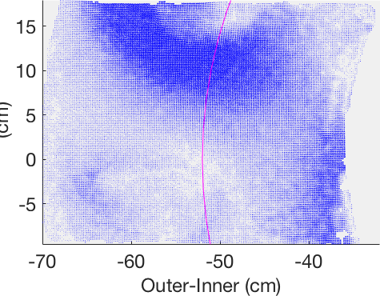
Surface temperature
Horizontal divergence
Snapshot of the horizontal divergence field: small-scale wavy structures trace the core of the baroclinic jet

Slide 20
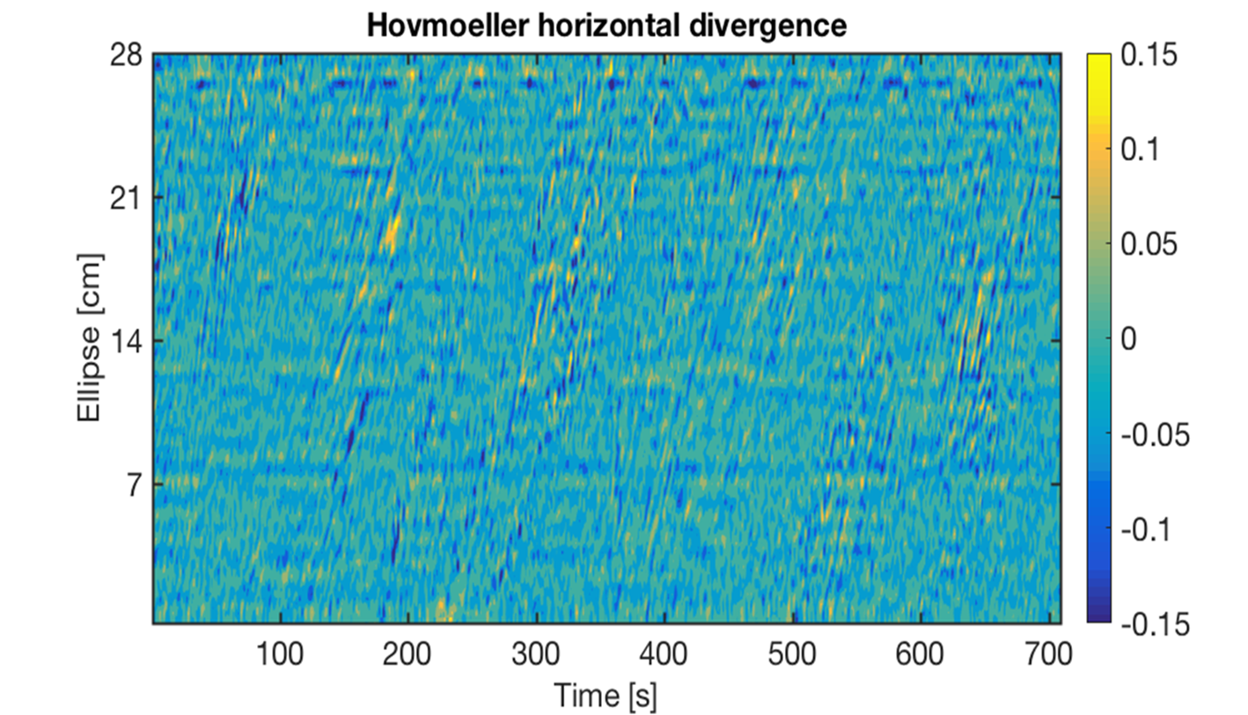

Slide 21
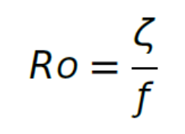
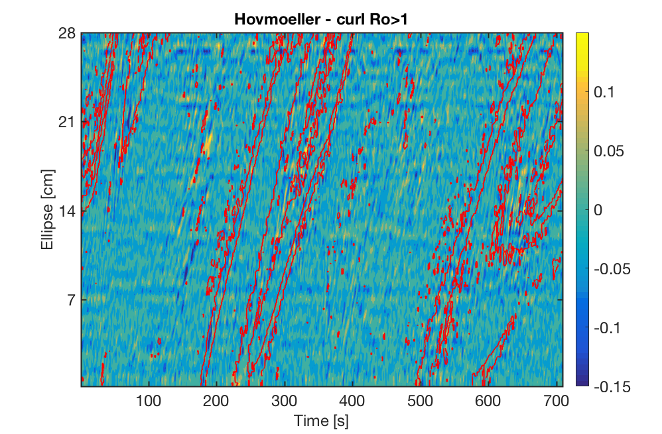

Slide 22
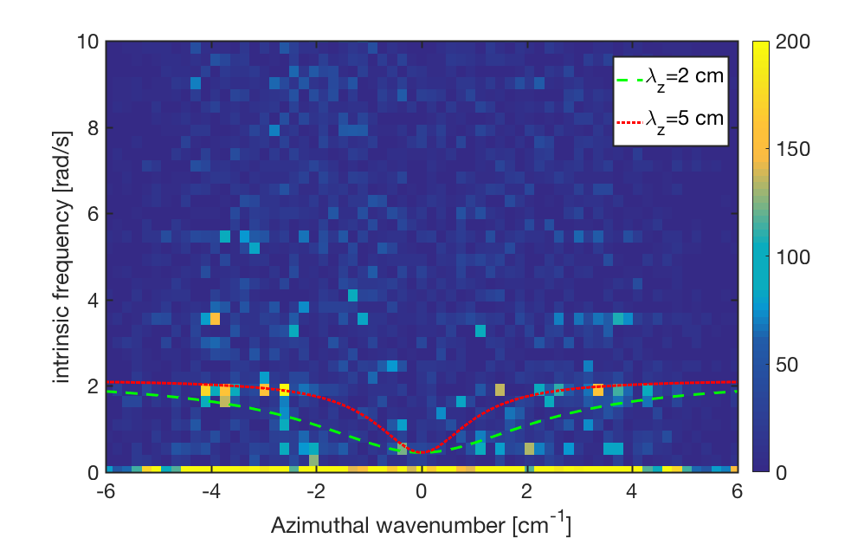
Dispersion curves for inertia-gravity waves
w
+
, f<w_{i}<N

Slide 23
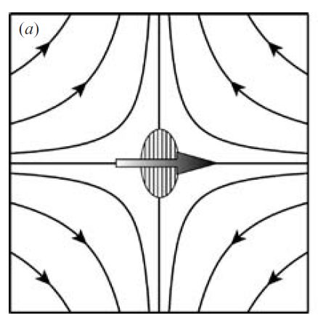
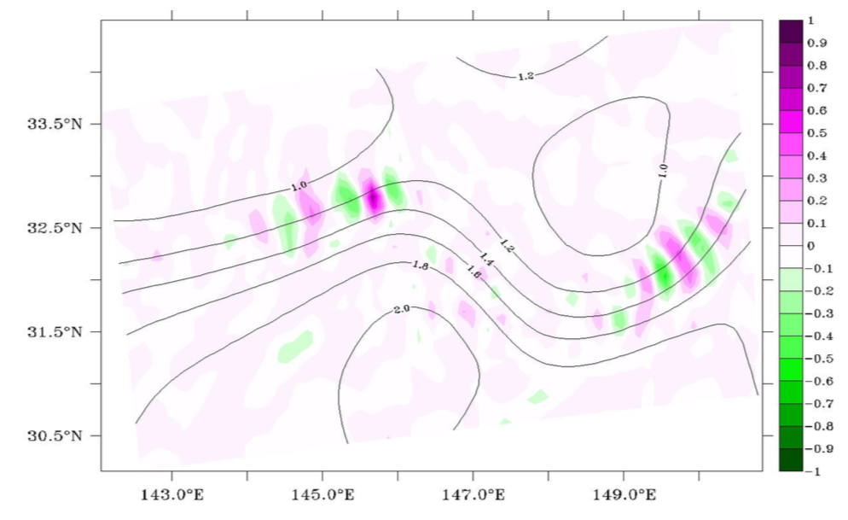

Wave capture
Plougonven and Zhang 2014, Rev. of Geophys., 52, 37pp.
Bühler and McIntyre, JFM, 2005
Jin-Song von Storch, Gualtiero Badin and Marcel Oliver, submitted, Springer 2018
Wave crests perpendicular to flow
Large amplitude
Large vertical wavelength
Wave propagates with the local flow U

Slide 24
Wave capture
Bühler and McIntyre, JFM, 2005
Jin-Song von Storch, Gualtiero Badin and Marcel Oliver, 2018
Wave crests perpendicular to flow
Large amplitude
Large vertical wavelength
Wave propagates with the local flow U

Slide 25
Wave capture
Bühler and McIntyre, JFM, 2005
Jin-Song von Storch, Gualtiero Badin and Marcel Oliver, 2018
Wave crests perpendicular to flow direction
Large amplitude
Large vertical wavelength
Wave propagates with the local flow U

Slide 26
Wave capture
Bühler and McIntyre, JFM, 2005
Jin-Song von Storch, Gualtiero Badin and Marcel Oliver, 2018
Wave crests perpendicular to flow
Large amplitude
Large vertical wavelength
Wave propagates with the local flow U

Slide 27
Wave capture
Bühler and McIntyre, JFM, 2005
Jin-Song von Storch, Gualtiero Badin and Marcel Oliver, 2018
Wave crests perpendicular to flow
Large amplitude
Large vertical wavelength
Wave propagates with the local flow U

Slide 28
Conclusion
We find a gravity wave signal that does not result from boundary layer or shear instabilities but is correlated with regions of large Ro
Wave capture might explain the spatial structure of the wave field (but not its source)
Comparisons with numerical results are underway but differences in the spatio-temporal structure need to be explained

Slide 29
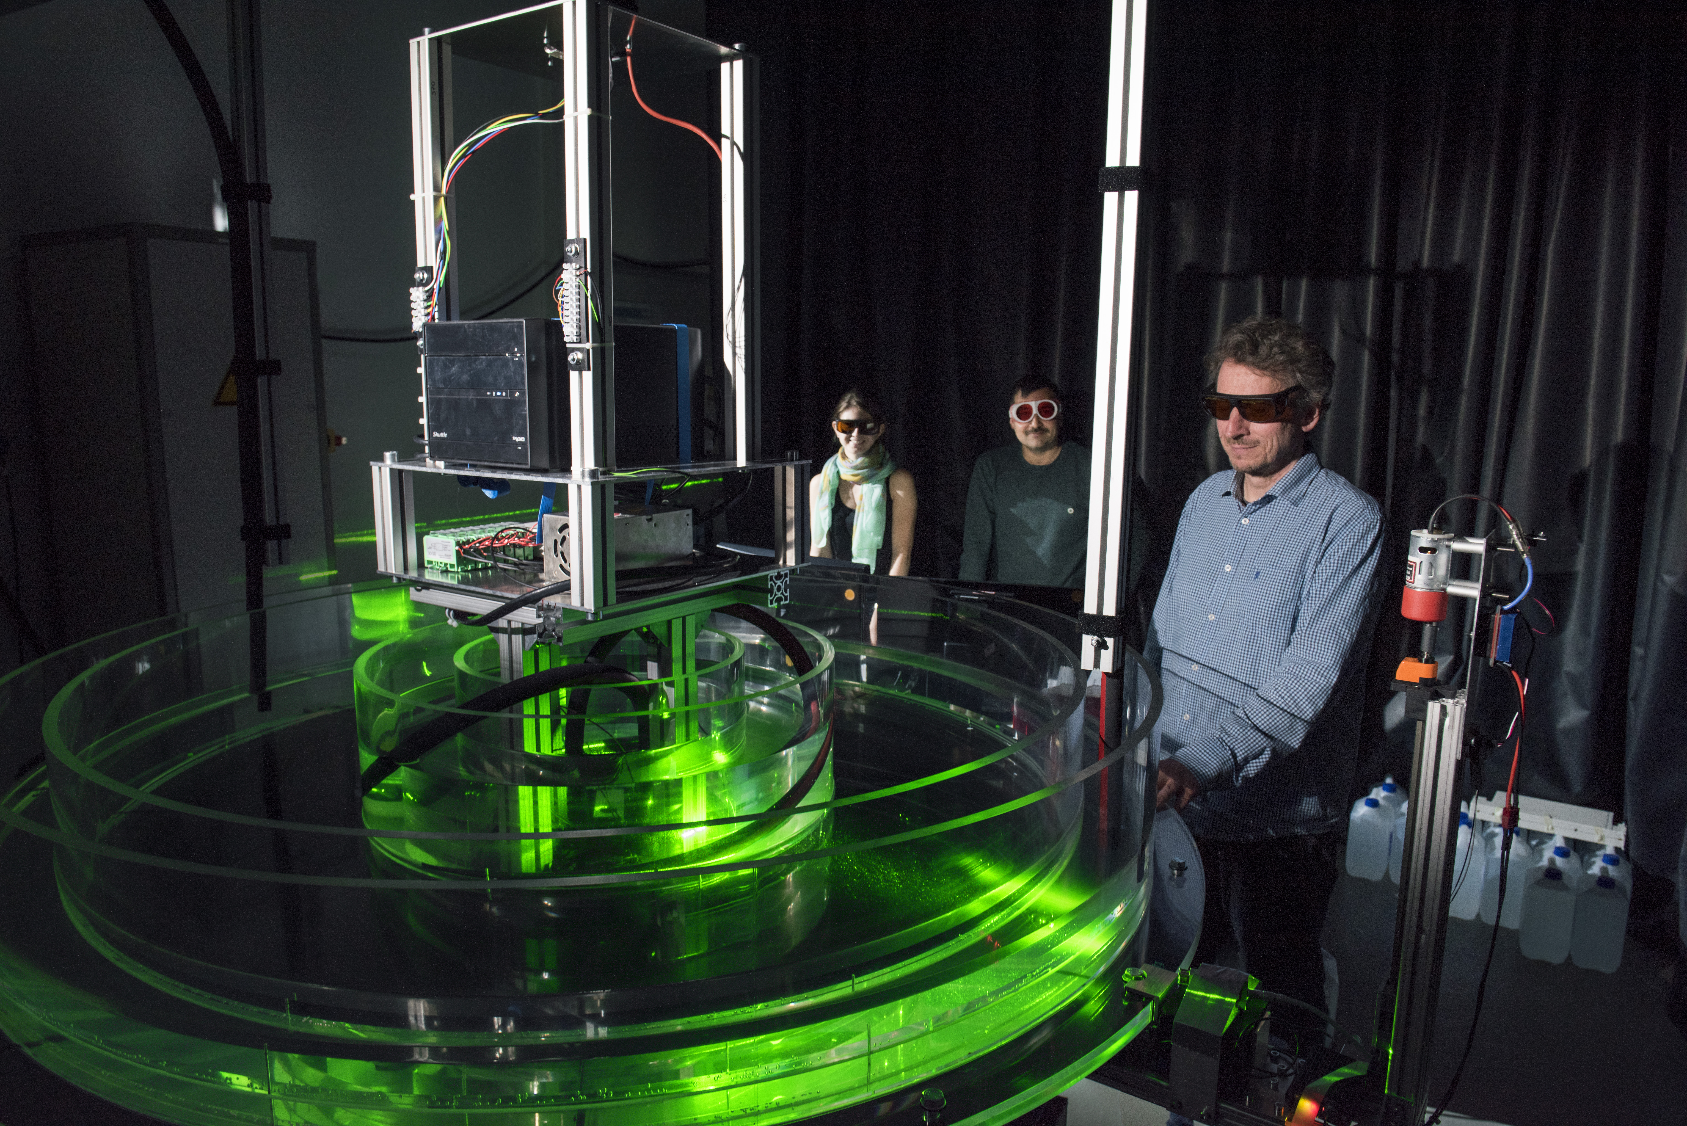
Thank you for your attention!
I thank all the BTU technicians for help. Thanks to DFG for financial support.

Slide 30
Laboratory experiments are a useful tool to study fundamental
processes of geophysical flows.
In contrast to field experiments data can be compiled in a controlled and reproducible way.
The data can be used
to study flows for parameter regimes not accessible for numerical simulations (Grenoble)
to test theoretical concepts (QBO, MS-GWaves)
to validate numerical simulations (DFG-MetStröm)
to test parameterization schemes (MS-GWaves)

